Slide 1
Unit-V
Backtracking

Slide 2
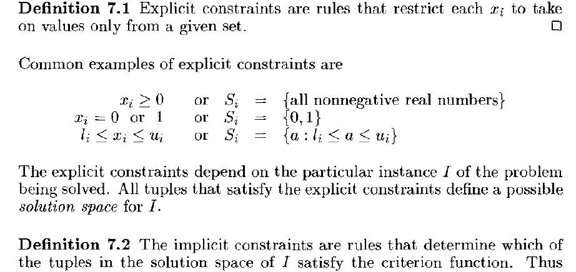
( Answers to the given problem )

Slide 3
Difficult Problems
Partition
  Partition n positive integers s₁, s₂, s₃, …, s_{n} into two groups A and B such that the sum of the numbers in each group is the same.
  [9, 4, 6, 3, 5, 1,8]
  A = [9, 4, 5] and B = [6, 3, 1, 8]

Slide 4
Subset Sum Problem
  Does any subset of n positive integers s₁, s₂, s₃, …, s_{n} have a sum exactly equal to c?
  [9, 4, 6, 3, 5, 1,8] and c = 18
  A = [9, 4, 5]

Slide 5
Traveling Salesperson Problem (TSP)
Let G be a weighted directed graph.
A tour in G is a cycle that includes every vertex of the graph.
TSP => Find a tour of shortest length.

Slide 6
n-Queens Problem
A queen that is placed on an n x n chessboard, may attack with any other queen placed in the same column, row, or diagonal.
8x8 Chessboard

Slide 7
Can n queens be placed on an n x n chessboard so that no queen attacks another queen?
4x4
Notes:
Problem may be solved in O(n) time by considering the cases: n is odd, n mod 6 = 2, else (n is even and n mod 6 != 2). However, solution eluded researchers for years. Although problem is no longer hard, it was hard for quite a while. See Explicit solutions to the N-queens problem for all N, Bo Bernhardsson, ACM SIGART Bulletin, 2(2), page 7. No placement is possible for n < 4. For n >= 4, the placement is always possible.

Slide 8
8x8

Slide 9
Difficult Problems
Many difficult problems require you to find either a subset or permutation that satisfies some constraints and (possibly also) optimizes some objective function.
These may be solved by organizing the solution space into a tree and systematically searching this tree for the answer.

Slide 10
Solution Space
Solution Space is a set that includes at least one solution to the problem.
Subset problem.
  n = 2, {00, 01, 10, 11}
  n = 3, {000, 001, 010, 100, 011, 101, 110, 111}
Solution space for subset problem has 2^{n} members.
Non systematic search of the space for the answer takes O(2^{n}) time.

Slide 11
Solution Space
Permutation problem.
  n = 2, {12, 21}
  n = 3, {123, 132, 213, 231, 312, 321}
Solution space for a permutation problem has n! members.
Non systematic search of the space for the answer takes O(n!) time.

Slide 12
Backtracking and Branch and Bound
Backtracking and branch and bound perform a systematic search and take much less time than the time taken by a non systematic search.

Slide 13
Tree Organization Of Solution Space
Set up a tree structure such that the paths from root to leaves represent members of the solution space.
For a size n subset problem, this tree structure has 2^{n} leaves.
For a size n permutation problem, this tree structure has n! leaves.
The tree structure is too big to store in memory; it also takes much time to create the tree structure.
Portions of the tree structure are created by the backtracking and branch and bound algorithms as needed.
Notes:
Tree organizations in which nonleaf nodes represent members of the solution space are also possible.

Slide 14
Subset Problem tree structure
Use a full binary tree that has 2^{n} leaves.
At level i the members of the solution space are partitioned by their x_{i} values.
Members with x_{i} = 1 are in the left subtree.
Members with x_{i} = 0 are in the right subtree.

Slide 15
Subset Tree For n = 4
( fixed – sized tuple )
x₁=1
x₁= 0
x₂=1
x₂= 0
x₂=1
x₂= 0
x₃=1
x₃= 0
x₄=1
x₄=0
0111
0001
1110
1011

Slide 16
Permutation Problem tree structure
Use a tree that has n! leaves.
At level i the members of the solution space are partitioned by their x_{i} values.
Members (if any) with x_{i} = 1 are in the first subtree.
Members (if any) with x_{i} = 2 are in the next subtree.
And so on.

Slide 17
Permutation Tree For n = 3
x₁=1
x₁= 3
x₁=2
x₂= 2
x₂= 3
x₂= 1
x₂= 3
x₂= 1
x₂= 2
x₃=3
x₃=2
x₃=3
x₃=1
x₃=2
x₃=1
123
132
213
231
312
321

Slide 18
Backtracking
Searches the solution space tree in a depth-first manner.
Will be done recursively.
The solution space tree exists only in your mind, not in the computer.

Slide 19
Backtracking Depth-First Search
x₁=1
x₁= 0
x₂=1
x₂= 0
x₂=1
x₂= 0

Slide 20
Backtracking Depth-First Search
x₁=1
x₁= 0
x₂=1
x₂= 0
x₂=1
x₂= 0

Slide 21
Backtracking Depth-First Search
x₁=1
x₁= 0
x₂=1
x₂= 0
x₂=1
x₂= 0

Slide 22
Backtracking Depth-First Search
x₁=1
x₁= 0
x₂=1
x₂= 0
x₂=1
x₂= 0

Slide 23
Backtracking Depth-First Search
x₁=1
x₁= 0
x₂=1
x₂= 0
x₂=1
x₂= 0

Slide 24
n – queens problem:-
The problem is to place n queens on an n×n chessboard so that no two “attack” that is no two queens on the same row, column, or diagonal.

Slide 25
Defining the problem:-
Assume rows and columns of chessboard are numbered 1 through n.
Queens also be numbered 1 through n.
Since each queen must be on a different row ,hence assume queen i is to be placed on row i.
Therefore all solutions to the n-queens problem can be represented as n-tuples ( x₁,x₂,…..x_{n}), where x_{i} is the column on which queen i is placed.

Slide 26
Tree structure for the case n=4.

Slide 27
1
X₁=1
X₁=4
X₁=2
X₁=3
2
34
50
18
x₂=
1
2
4
1
2
3
2
3
4
1
3
4
3
8
13
19
24
29
35
40
45
51
56
61
x₃=
3
4
2
4
2
3
3
4
1
4
1
3
2
4
1
4
1
2
2
3
1
3
1
2
4
6
9
11
14
16
20
22
25
27
30
32
36
38
41
43
46
48
52
54
57
59
62
64
x₄=
4
3
4
2
3
2
4
3
4
1
3
1
4
2
4
1
2
1
3
2
3
1
2
1
5
7
10
12
15
17
21
23
26
28
31
33
37
39
42
44
47
9
53
55
58
60
63
65
Tree organization of the 4-queens solution space. Nodes are numbered as in depth first search.

Slide 28
1
x₁=1
x₁=2
2
18
x₂=2
x₂=3
x₂=4
x₂=4
3
8
13
29
19
24
B
B
B
x₃=1
9
11
14
16
30
B
B
B
x₄=3
15
31
B
Portion of the tree that is generated during backtracking( n=4 ).

Slide 29
n - queens problem algorithm
Every element on the same diagonal that runs from the upper left to the lower right has the same row – column value.
Similarly, every element on the on the same diagonal that goes from the upper right to the lower left has the same row + column value.

Slide 30
If two queens are placed at positions ( i, j ) and ( k, l ) , then they are on the same diagonal only if
i – j = k – l or i + j = k + l
First equation implies
j – l = i – k
Second equation implies
j – l = k – i
Therefore, two queens lie on the same diagonal if and only if j – l = i – k

Slide 31
Algorithm place( k, l )
// It returns true if a queen can be placed in column l
// It tests both whether i is distinct from all previous values
// x [ 1 ], ….x [ k-1 ] and there is other queen on the same
//diagonal.
// Abs(r) returns the absolute value of r.
{
for j = 1 to k-1 do // for all previous queens
{ // Two in the same column or in the same diagonal
if ( ( x [ j ] = l ) or ( Abs( x[ j ] - l ) = Abs( j - k ) ) ) then
return false;
}
return true ;
}

Slide 32
Algorithm NQueen(k,n)
//Using backtracking, this procedure prints all
//possible placements of n queens on an n×n
//chessboard so that they are nonattacking.
{
for l =1 to n do // check place of column for queen k
{
if place( k, l ) then
{
x[ k ] = l;
if( k = n )then write( x[1:n] );
else NQueens( k+1, n);
}
}
}

Slide 33
Sum of subsets
Given n distinct positive numbers w_{i}, and m, find all subsets that sum to m.
We can formulate this problem using either
  Fixed- or variable – sized tuples.

Slide 34
Variable- sized tuple
Ex:- n=4, ( w1, w2, w3, w4 )= ( 11,13, 24, 7 ), m=31.
  Solutions are ( 11, 13, 7 ) and ( 24, 7 )
Rather than representing the solution by w_{i} ’s, we can represent by giving the indices of these w_{i}
Now the solutions are ( 1, 2, 4 ) and ( 3, 4 ).
Different solutions may have different-sized tuples.
We use the following condition to avoid generating multiple instances of the same subset ( e.g., ( 1,2,4) and (1,4,2) )
  x_{i} < x_{i+1}

Slide 35
Subset Tree for n=4 (variable- sized tuple )
1
x₁=1
x₁=4
x₁=2
x₁=3
3
4
5
2
x₂=4
x₂=3
x₂=4
x₂=4
x₁=2
x₂=3
8
9
10
11
6
7
x₃=3
x₃=4
x₃=4
x₃=4
12
13
14
9
x₄=3
16
Nodes are numbered as in Breadth first search.

Slide 36
Fixed- sized tuple
In this method, each solution subset is represented by an n-tuple (x₁,x₂,…..x _{n}).
x _{i}=0 if w_{i} is not chosen and x_{i}=1 if w_{i} is chosen
Subset Tree for n=4 (Fixed- sized tuple )
We have already discussed.
Copy that tree.

Slide 37
Subset Tree For n = 4
( fixed – sized tuple )
x₁=1
x₁= 0
x₂=1
x₂= 0
x₂=1
x₂= 0
x₃=1
x₃= 0
x₄=1
x₄=0
0111
0001
1110
1011

Slide 38
Algorithm of sum of subsets
Backtracking solution using fixed- sized tuple.
A simple choice for bounding function is B_{k}(x₁,x₂,…..,x_{k})= true iff
∑ w_{i}x_{i} + ∑ w_{i} ≥ m
Clearly x₁,x₂,……x_{k} cannot lead to an answer node if this condition is not satisfied.
k
n
i=1
i=k+1

Slide 39
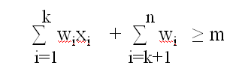
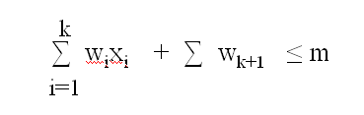
The bounding function strength further can be increased if we assume the w_{i}’s in increasing order.
In this case x₁,x₂,……x_{k} cannot lead to an answer node if
∑ w_{i}x_{i} + ∑ w_{k+1} > m
Therefore, the bounding functions we use are
  B_{k}(x₁,x₂,…..,x_{k})= true iff
k
i=1
and

Slide 40
The initial call is SumOfSub( 0, 1, ∑ w_{i} )
Algorithm SumOfSub( s, k, r )
// Find all subsets of w[ 1:n ] that sum to m
// It is assumed that w[1] ≤ m and ∑ w_{i} ≥ m
// The values of x[j] 1<=j<k, have already been determined.
// s= ∑ w[j]*x[j] and r= ∑ w[j] . W[j]’s in increasing order.
{
x[ k ]=1; // left child
if( s + w[k] = m ) then write( x[ 1: k ] ) ; // Subset found
else if ( s + w [ k ] + w[ k+1 ] ≤ m )
then SumOfSub( s+ w[k], k+1, r- w[k] )
n
i=1
n
i=1
K-1
n
j=1
j=k

Slide 41
// Generate right child and evaluate B_{k}
if ( ( s + r – w[ k ] ≥ m ) and ( s + w[ k+1 ] ≤ m ) ) then
{
x[ k ] = 0;
} SumOfSub( s, k+1, r- w[k] ) ;
}

Slide 42
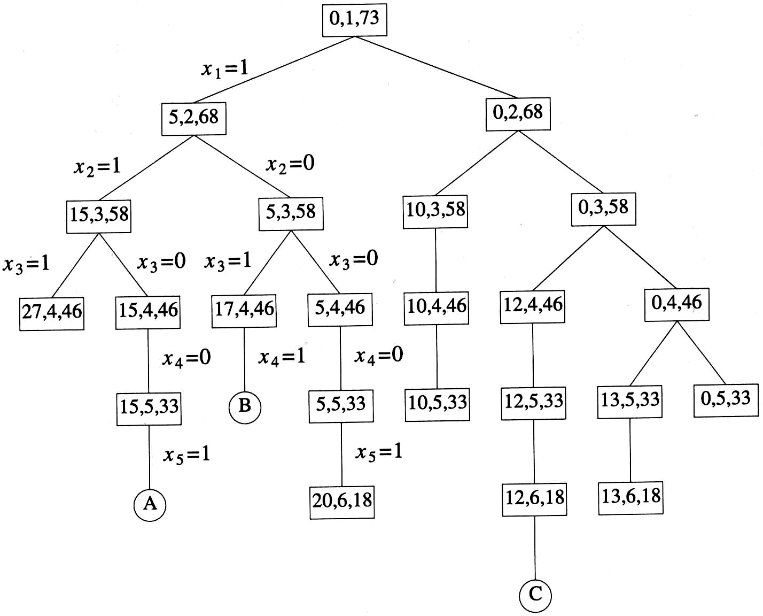
Ex:- n=6, m=30, w [ 1:6 ]= { 5,10,12,13,15,18 }
Portion of state space tree generated by SumOfSub. circular nodes indicate subsets with sums equal to m.
Example 7.6 (Figure 7.10)
  n=6, w[1:6]={5,10,12,13,15,18}, m=30

Slide 43
Graph Coloring Problem
Assign colors to the vertices of a graph so that no adjacent vertices share the same color.
  Vertices i, j are adjacent if there is an edge from vertex i to vertex j.

Slide 44
Example
No.of Colors used: 2
Number of Possible ways : 2

Slide 45
No.of Colors used: 3
.
.
.
Some possible ways

Slide 46
M-colorability optimization problem asks for the smallest integer for which the graph can be colored.
This number is called chromatic number.

Slide 47
m-colorings problem:-
  Find all ways to color a graph with at most m colors.
  Problem formulation:-
  Represent the graph with adjacency matrix G[1:n,1:n].
  The colors are represented by integer numbers 1,2,….m.
  Solution is represented by n- tuple (x₁,….x_{n}), where x_{i} is the color of node i.

Slide 48
Solution space tree for mColorigng when n=3 and m=3
x₁=1
2
3
3
1
3
1
3
x₂ =1
2
2
2
X3 =1
2
3

Slide 49
A 4-node graph and all possible 3-colorings
1
2
4
3
x₁=
1
2
3
X₂=
2
3
1
3
1
2
X₃=
1
3
1
2
2
3
1
2
2
3
1
3
X₄=
2
3
2
2
3
3
1
3
1
3
1
3
1
1
2
2
1
2

Slide 50
Algorithm :- finding all m- colorings of a graph.
Function mColoring is begun by first assiging the graph to its adjacency matrix, setting the array x[ ] to zero, and then invoking the statement mColoring( 1 );
Algorithm mColoring( k )
// k is the index of the next vertex to color.
{
repeat
{ // Generate all legal assignments for x[k]
NextValue( k ); // Assign to x[k] a legal color
if ( x[k]=0 ) then return; // No new color possible
if ( k=n ) then // At most m colors have been used to color the n vertices
write( x[1:n] );
else mColoring( k+1);
} until ( false );
}

Slide 51
Algorithm NextValue( k )
// x[1],…..x[ k-1 ] have been assigned integer values in the range [ 1 ,m ].
// A value for x[ k ] is determined in the range [ 0,m ]
{
repeat
{
x[k] = ( x[k] +1) mod ( m+1 ); // Next highest color.
if ( x[k]=0 ) then return; // All colors have been used.
for j = 1 to n do
{
if (( G[ k, j ] ≠ 0 ) and ( x[k] = x[j] )) then
break;
}
if( j = n+1 ) then return; // Color found
} until ( false );
}

Slide 52
Hamiltonian cycles:-
A Hamiltonian cycle is a round-trip path along n edges of connected undirected graph G that visits every vertex once and returns to its starting position.
The above graph contains the Hamiltonian cycle
1,2,8,7,6,5,4,3,1
1
2
3
4
8
7
6
5

Slide 53
The above graph does not contain Hamiltonian cycles.
1
2
3
5
4

Slide 54
  Find all possible Hamiltonian cycles
  Problem formulation:-
  Represent the grapth with adjacency matrix G[1:n,1:n].
  Solution is represented by n- tuple (x₁,….x_{n}), where x_{i} represents the i^{th} visited vertex of the cycle.
  Start by setting x[ 2: n ] to zero and x[ 1 ]=1, and then executing Hamiltonian( 2 );

Slide 55
Algorithm Hamiltonian( k )
{
repeat
{ // Generate values for x[k]
NextValue( k ); // Assign a legal next value to x[ k ]
if ( x[k]=0 ) then return; // No new value possible
if ( k=n ) then write( x[1:n] );
else Hamiltonian( k+1);
} until ( false );
}

Slide 56
Algorithm NextValue( k )
{
repeat
{
x[k] = ( x[k] +1) mod ( n+1 ); // Next vertex.
if ( x[k]=0 ) then return;
if( G[ x[ k-1], x[ k ] ] ≠ 0 )
{
for j:= 1 to k-1 do if ( x[ j ] = x [k ] ) then break;
if( j = k ) then // if true, then the vertex is distinct
if( ( k < n ) or ( ( k=n ) and G [ x[n], x[1]] ≠ 0 )
then return;
}
} until ( false );
}

Slide 57
General Backtracking Algorithms :-
Assume all answer nodes are to be found.
Let (x1,x2,…..,xi) be a path from the root to a node xi in a state space tree .
Let T(x1,x2,…..xi) be the set of all possible paths for x_{i+1} such that (x1,x2,…….., x_{i+1}) is also a path to a problem state.
Assume bounding functionBi+1 ( implicit conditions) such that if Bi+1(x1,x2,……,xi+1) is false for a path (x1,x2,…xi+1) , then the path cannot be expanded to reach an answer node.

Slide 58
General Recursive backtracking Algorithm:-
Algorithm Backtrack( k )
// The first k-1 values have been assigned.
// x[ ] and n are global.
{
for ( each x[k] € T(x[1],……x[k-1] )
{
if( Bk( x[1],x[2],…..x[k] ≠ 0) then
{
if(x[1],x[2],…..x[k] is a path to answer node )
then write( x[1:k] );
if ( k < n) then Backtrack( k+1 );
}
}
}

Slide 59
Branch and Bound
( unit-vii )
Backtracking is effective for subset or permutation problems.
Backtracking is not good for optimization problems.
This drawback is rectified by using Branch And Bound technique.
Branch And Bound is applicable for only optimization problems.
Branch and Bound also uses bounding function similar to backtracking.

Slide 60
Terminology of tree organization
Problem state :-
Each node in the tree is a problem state.
Ex :-
and so on
State Space :-
All paths from the root to problem states define the state space of the problem.
1
2
18

Slide 61
Solution States :-
These are those problem states S for which the path from the root to S define a tuple in the solution space.
Ex:-
and so on
Solution Space :-
All paths from the root to solution states define the solution space of the problem.
5
7
10
12
15
17
21

Slide 62
Ex :-
1
X₁=1
X₁=4
X₁=2
X₁=3
2
34
50
18
x₂=
1
2
4
1
2
3
2
3
4
1
3
4
3
8
13
19
24
29
35
40
45
51
56
61
x₃=
3
4
2
4
2
3
3
4
1
4
1
3
2
4
1
4
1
2
2
3
1
3
1
2
4
6
9
11
14
16
20
22
25
27
30
32
36
38
41
43
46
48
52
54
57
59
62
64
x₄=
4
3
4
2
3
2
4
3
4
1
3
1
4
2
4
1
2
1
3
2
3
1
2
1
5
7
10
12
15
17
21
23
26
28
31
33
37
39
42
44
47
9
53
55
58
60
63
65
Tree organization of the 4-queens solution space. Nodes are numbered as in depth first search.

Slide 63
  A node which has been generated and all of whose children have not yet been generated is called a live node.
  The live node whose children are currently being generated is called E-node ( Expanding node ).
  A dead node is a generated node which can not to be expanded further or all of whose children have been generated.

Slide 64
Branch And Bound
Nodes will be expanded in three ways.
FIFO branch and bound-- queue
LIFO branch and bound-- stack
Least-Cost (or max priority) branch and bound)—priority queue.

Slide 65
Least-cost branch and bound directs the search to the parts which most likely to contain the answer.

Slide 66
Ex:- 4 – Queens Problem
FIFO Branch And Bound Algorithm

Slide 67
Portion of 4 – queens state space tree generated by FIFO branch and bound
1
x₁=1
3
4
2
2
3
4
5
2
3
4
1
3
4
1
2
4
1
3
2
6
7
8
9
10
11
12
13
14
15
16
17
18
19
20
21
22
23
24
25
26
27
28
29
30
Answer node

Slide 68
In this case backtracking method is superior than branch and bound method.

Slide 69
Least Cost ( LC) search :-
In both FIFO and LIFO branch and bound the selection rule for the next E-node does not give any preference to a node that has a very good chance of getting an answer node quickly.
In the above example when node 22 is generated, it should have become obvious that this node will lead to an answer node in one move.
However , the FIFO rule first requires the expansion of all live nodes generated before node 22 was expanded.

Slide 70
The search for an answer node can be speeded by using an “intelligent “ ranking function c (.) for live nodes.
The next E-node is selected on the basis of this ranking function.
If we use ranking function that assigns node 22 a better rank than all other live nodes , then node 22 will become the E-node following node 29.
^

Slide 71
The ideal way to assign ranks will be on the basis of the additional effort ( cost) needed to reach an answer node from the live node.
For any node x, this could be
1) The number of nodes in the subtree with root x that need
to be generated before an answer node is generated.
OR more simply
2) The number of levels in the subtree with root x that need
to be generated to get an answer node.
Using cost measure 2,
In the above fig. the cost of the root is 4 ( node 30 is four levels from node 1) .

Slide 72
The difficulty with cost functions is that computing the cost of the node usually involves a search of the subtree x for an answer node.
Hence , by the time the cost of a node is determined , that subtree has been searched and there is no need to explore x again. For this reason , search algorithms usually rank nodes only on the basis of an estimated cost g( . ) .
^

Slide 73
^
Let g(x) be an estimate of the additional cost needed to reach an answer node from x.
Then , node x is assigned a rank using a function c(.) such that
c(.) = h(x) + g(x)
where
h(x) is the cost of reaching x from the root
^
^
^

Slide 74
Actual cost function c(.) is defined as follows:
  if x is an answer node , then c(x) is the cost of reaching x from the root .
  if x is not an answer node , then c(x)=∞, it means that subtree with root x contains no answer node.
  otherwise c(x) equal to the cost of a minimum cost answer node in the subtree with root x.
c(.) is an approximation to c(.)
^

Slide 75
A FIFO or LIFO search always generates the state space tree by levels.
What we need is more “intelligent” search method .
We can associate a cost c(x) with each node x in the state space tree.
The cost c(x) is the length of a path from the root to a nearest goal node( if any ) in the subtree with root x.
Thus in the above fig c(1)=c(4)=c(10)=c(23)=3.
When such a cost function is available, a very efficient search can be carried out.
In this search strategy , the only nodes to become E-nodes are nodes on the path from the root to a nearest goal node.

Slide 76
Unfortunately, this is an impractical.
We can only compute estimate c(x) of c(x). we can write
c(x)=f(x) +g(x), where f(x) is the length of the path from the root to node x and g(x) is an estimate of the length of a shortest path from x to a goal node in the subtree with root x.
one possible choice for g( x ) is
g( x ) = number of nonblank tiles not in their goal position.
^
^
^
^
^
^

Slide 77
Control Abstraction of LC-Search:-
Algorithm LCSearch( t )
// search tree t for answer node
{
if *t is an answer node then output *t and return;
E=t // E-node
repeat
{
for each child x of E do
{
  if x is an answer node then output the path from x to t and return;
  Add( x ); // x is a new live node
  ( x ->parent )=E // pointer for path to root
  }

Slide 78
if there are no more live nodes then
{
write(“ No answer node “);
return;
}
E=Least();
} until ( false )
}
( x ->parent )=E is to print answer path.

Slide 79
Bounding:-
The bounding functions are used to avoid the generation of sub trees that do not contain the answer nodes. In bounding upper and lower bounds are generated at each node.
A cost function c(.) such that c (x)<=c(x) is used to provide the lower bounds on solutions obtainable from any node x.
If upper is an upper bound on the cost of a minimum cost solution, then all live nodes x with c (x) >upper may be killed as all answer nodes reachable from x have cost c(x) >= c(x) > upper.
upper is updated whenever a child is generated.
^
^
^
^

Slide 80
0/1 Knapsack Problem
Generally Branch and Bound will minimize the objective function.
The 0/1 knapsack problem is a maximization problem.
This difficulty can be avoided by replacing the objective function ∑ p_{i}x_{i} by - ∑ p_{i}x_{i} .

Slide 81
Note:
1. All live nodes with c(x) > upper can be killed when they are about to become E-nodes .
^

Slide 82
LC Branch and Bound
Steps to be followed in LCBB
  Step 1:Compute c(.) and u(.) for a generated node, then if c >
  upper ( initially upper = u(root node ) ) immediately kill the
  node otherwise add the node to the list of live nodes.
  Step 2: Update upper = u(.), if upper is greater than u(.).
  Step 3: The Least Cost node will be the next E-node.
  Step 4: Whenever a node about become an E-node, check if c(.) is
  greater than upper, if yes kill the node otherwise generate its
  children. Also kill the nodes which are not feasible.
  Step 5: Continue step 1 to 4 till all the live nodes are expanded.
  Step 6 : Finally the highest U value ( absolute value ) node will be
  the answer node. Trace the path in backward direction
  from answer node to root node for solution subset.
^
^
^

Slide 83
^
LC Branch and Bound Solution
Upper number = c
Lower number = u
EX:- n=4, ( p1,p2,p3,p4 )= (10,10,12,18 )
( w1,w2,w3,w4 ) = ( 2,4,6,9 ), m=15
-38
1
-32
^
-38
-32
Process: The calculation of U and C is as follows.
U(1) - Scan through the objects from left to right and put into the knapsack until the first object that does not fit is encontered.
C(1) – Similar to U(1) except that it also considers a fraction of the first object that does not fit the knapsack.
Continue this process until an answer node is found.
-32
2
3
-22
k
-38
-32
4
5
-36
-22
k
-38
-32
6
-38
^
7
-38
-38
8
9
-20
X
-32
10
-38
-20
-32
Answer node
k
k

Slide 84
^
Let us trace the working of an LC Branch and Bound using c(.) and u(.) as defined previously.
The search begins with the root as the E-node. For this node, we have c(1)= -38 abd u(1)= -32. Initially, upper=u(1)= -32.
Since node 1 is not a solution node, its two children , node 2 & 3, are generated. The cost c(2) = -32, c(3) = -32, u(2)= -32 and u(3) = -22. Since both the nodes c()’s are not greater than the upper, nodes are put onto the list of live nodes.
Node 2 ( least cost ) is the next E-node. It is expanded and nodes 4 and 5 are generated. Both the nodes get added to the list of live nodes as their c()’s values are not greater than the upper.
Node 4 will be the next E-node , its children 6 and 7 are generated. Assuming node 6 is generated first, it is added to the list of live nodes. Next node 7 joins this list and upper is updated to -38.
The next E-node will be one of the nodes 6 and 7 ( least cost node ). Let us assume it is node 7. Its two children are nodes 8 and 9. Node 8 is put onto the live nodes list. Node 9 has c(9) > upper and is killed immediately.
^
^
^
^
^
^

Slide 85
contd..
Node 8 can not be expanded further as there are only 4 items.
Node 6 is the next E-node, its left child is not a feasible node. Node 10 is generated and killed immediately as its c(10) > Upper. Similarly node 3 and 5 are killed as their c()’s values are greater than upper. Node 8 is the answer node ( highest absolute u() value ).
Maximum profit is 38.
Solution (x1,x2,x3,x4 ) is (1,1,0,1).
^
^

Slide 86
FIFO Branch and Bound
Steps to be followed in FIFOBB
  Step 1:Compute c(.) and u(.) for a generated node, then if c >
  upper ( initially upper = u(root node ) ) immediately kill the
  node otherwise add the node to the list of live nodes.
  Step 2:Update upper = u(.), if upper is greater than u(.).
  Step 3:The next node in the queue ( FIFO ) will be the next E-node.
  Step 4:Whenever a node about to become an E-node, check if c(.) is
  greater than upper, if yes kill the node otherwise generate its
  children. Also kill the nodes which are not feasible.
  Step 5: Continue step 1 to 4 till all the live nodes are expanded.
  Step 6 : Finally the highest U value ( absolute value ) node will be
  the answer node. Trace the path in backward direction
  from answer node to root node for solution subset.

Slide 87
FIFO Branch and Bound
^
Upper number = c
Lower number = u
-38
1
-32
-38
-32
2
-32
3
-27
-38
-32
4
-36
-32
-28
5
-22
6
7
-27
-28
k
k
k
-38
-32
8
-38
9
-38
Tracing same as LCBB, except that
every time the E-node will be the
next element in the queue .
Max Profit is 38.
Solution is (1,1,0,1).
X
-32
10
12
-38
13
-20
-32
-38
-20
k
Answer node
k

Slide 88
Home Work :-
Draw the portion of the state space tree generated by LCBB and FIFIBB for the following knapsack problem.
a) n=5, ( p1,p2,p3,p4,p5 ) = ( 10,15,6,8,4 ),
( w1,w2,w3,w4,w5 )= ( 4,6,3,4,2 ) and m=12
b) n=5, ( p1,p2,p3,p4,p5 )= ( w1,w2,w3,w4,w5 )=
( 4,4,5,8,9 ) and m=15.

Slide 89
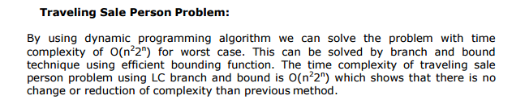
Problem Statement : If there are n cities and cost of traveling from any city to any other city is given. Then we have to obtain the shortest round-trip such that each city is visited exactly once and then returning to starting city, completes the tour.

Slide 90
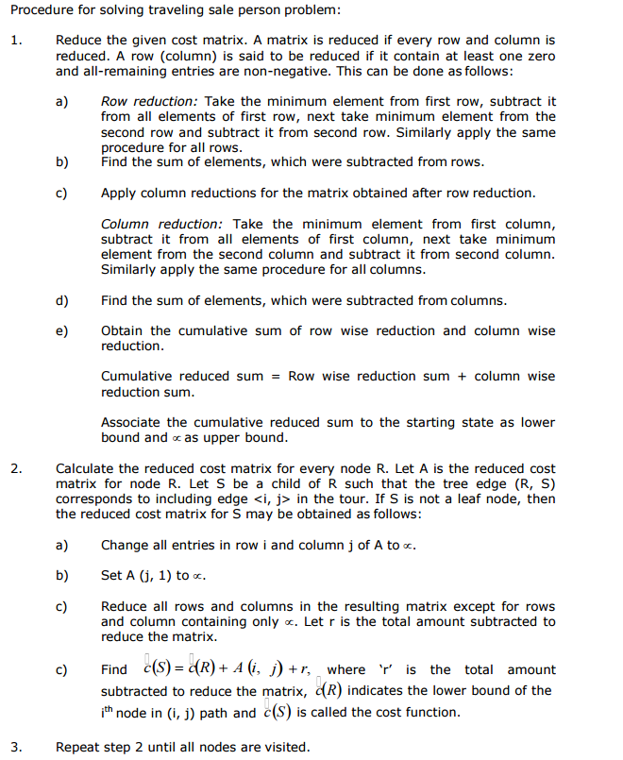

Slide 91
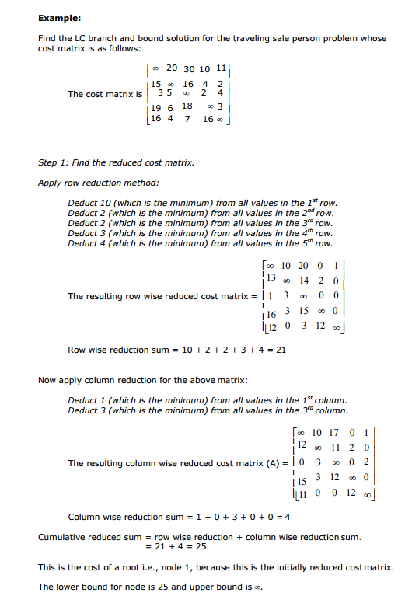

Slide 92
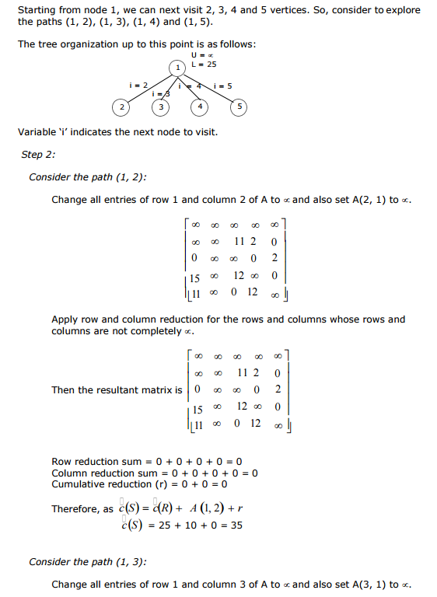

Slide 93
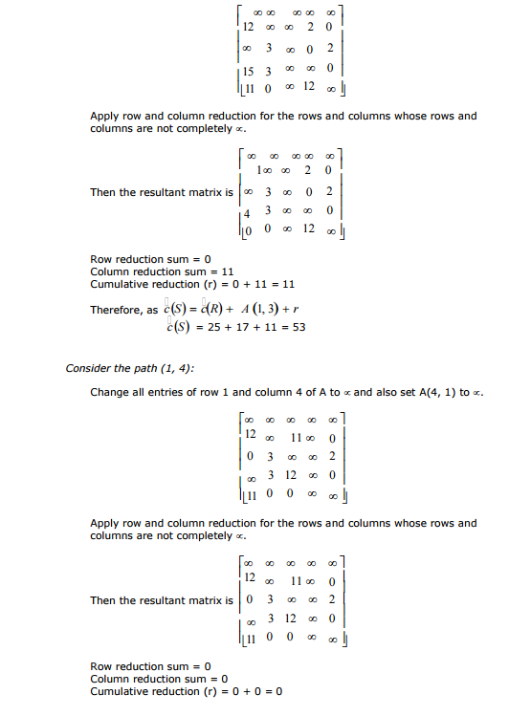

Slide 94
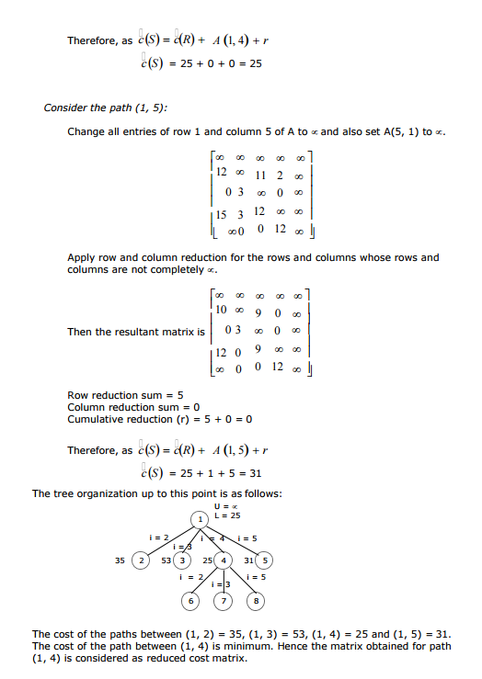

Slide 95
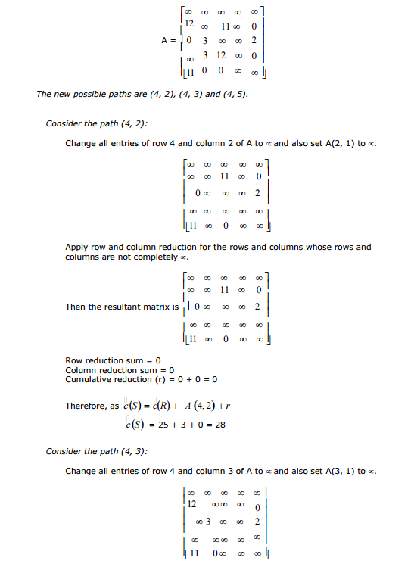

Slide 96
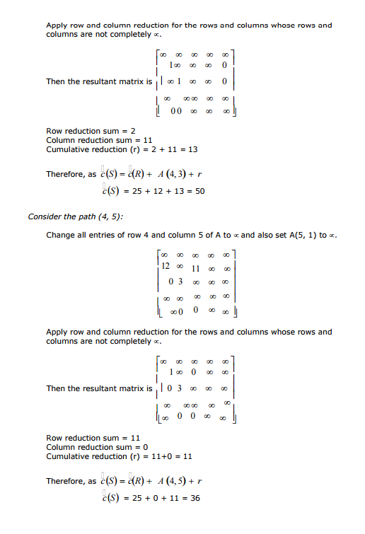

Slide 97
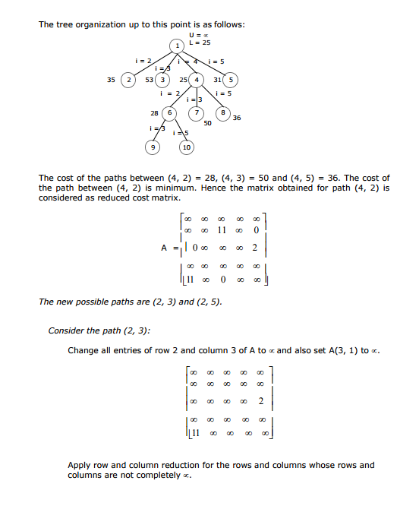

Slide 98
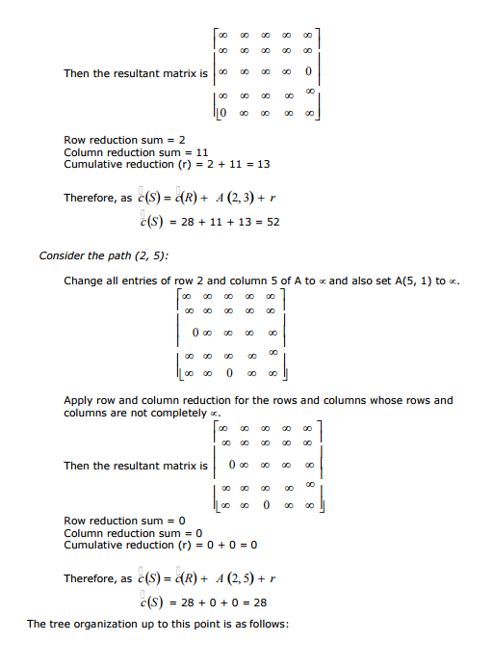

Slide 99
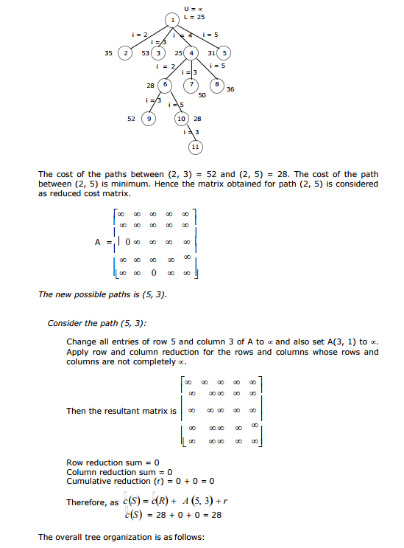

Slide 100
